Slide 1
Improvement of the Subject-Diffusion

Slide 2
Table of Contents
Remark: Our Project Goal
Remark: What is Subject Diffusion
Current Process of our project
Improvement of the Dataset
Improvement of the Model
Conclusion

Slide 3
Remark: Our Project Goal
Our Project Goal: Improving Subject-Diffusion.
Our plan:
Step 1: Improve the Dataset
Step 2: Try to train Subject-Diffusion by using the Dataset made in Step 1

Slide 4
Remark: What is Subject Diffusion?
Personalized image generation model
Only requires a single reference image
Support personalized generation of single- or two-subjects in any domain

Slide 5
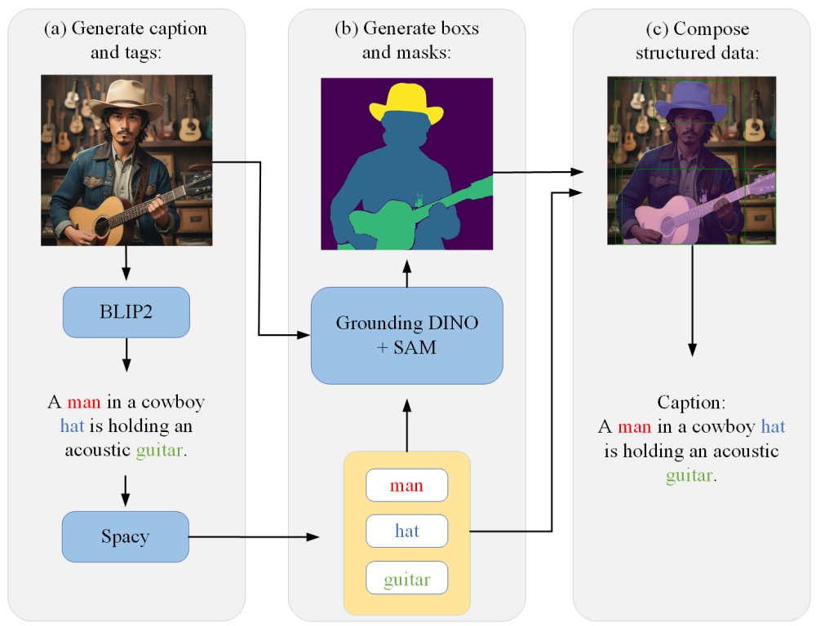
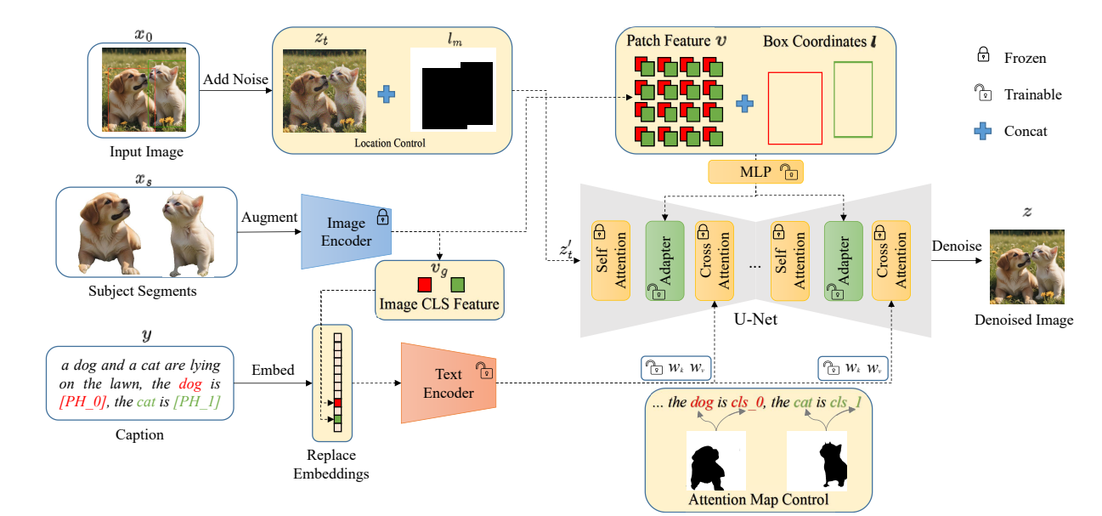
Remark - What is Subject-Diffusion?
Dataset Construction
2. Model of Subject Diffusion
Notes:
The paper can be divided as two main tasks - the dataset construction and subject diffusion model.

Slide 6
Our Progress
Step 1: Improve the DataSet
We try to use the dataset from the COCO and try to only distinguish the Image which has more than 3 objects

Slide 7
Our Progress
Improve the DataSet
Download the entire Dataset of the Coco
Try to filter the Images so that Image Set only contains the image which has more than 3 object
Make the Dataset using the Image Set Made from B

Slide 8
Our Progress
Step 1: Improve the DataSet
Download the Image set from the Coco
We had download the Image set from the Coco which has 118287 Images

Slide 9
Our Progress
Step 1: Improve the DataSet
B. Try to filter the Images so that Image set only contains the image which has more than 3 object By writing the classification code we had distinguished the 81892 Images which has more than 2 objects

Slide 10
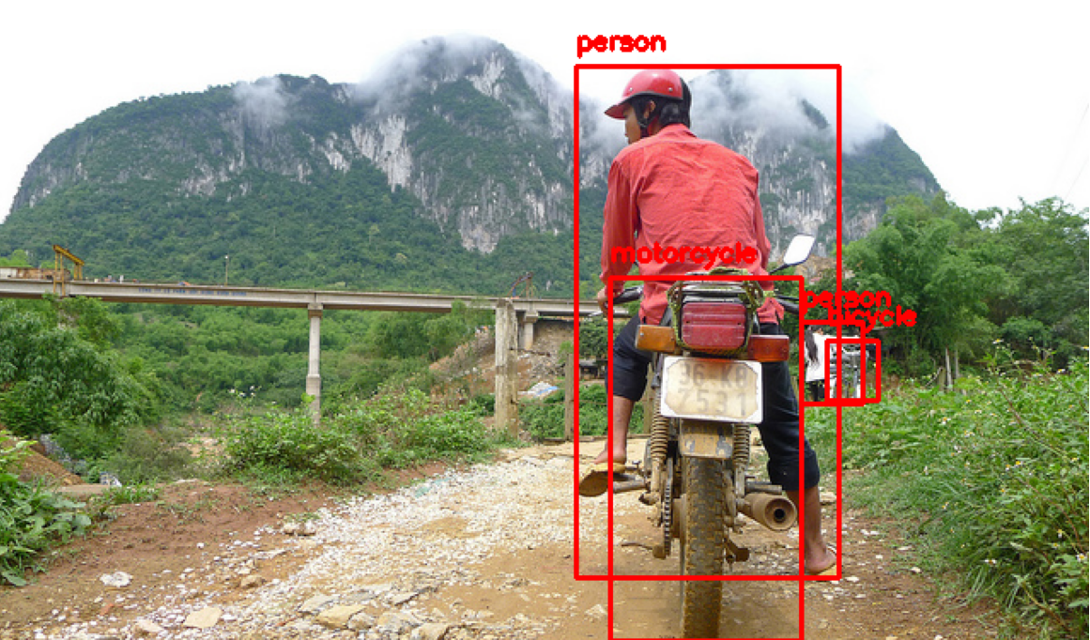
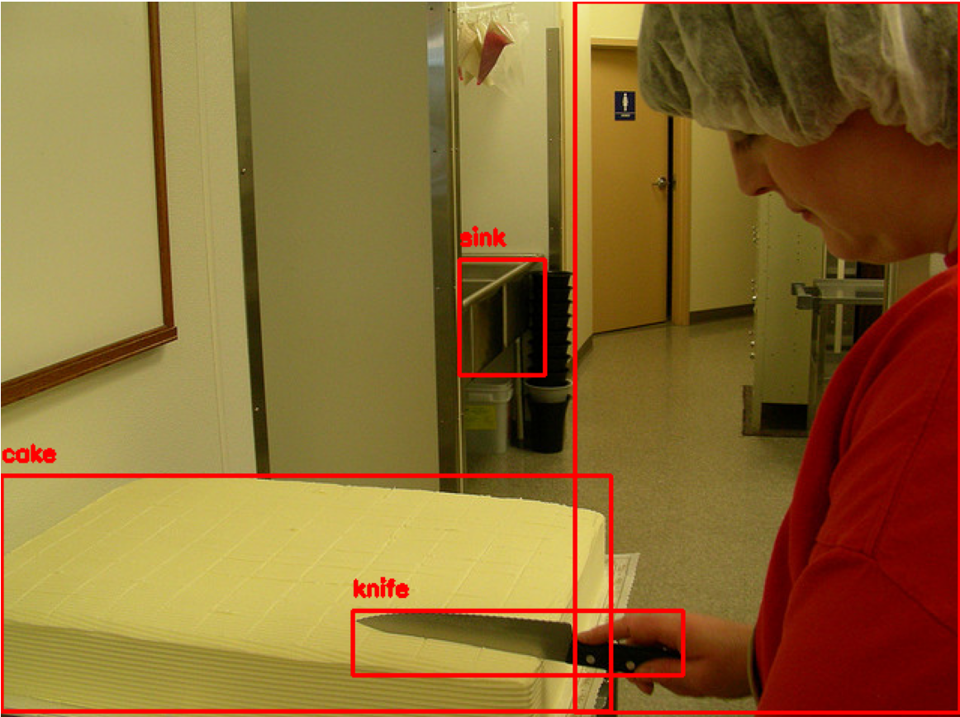
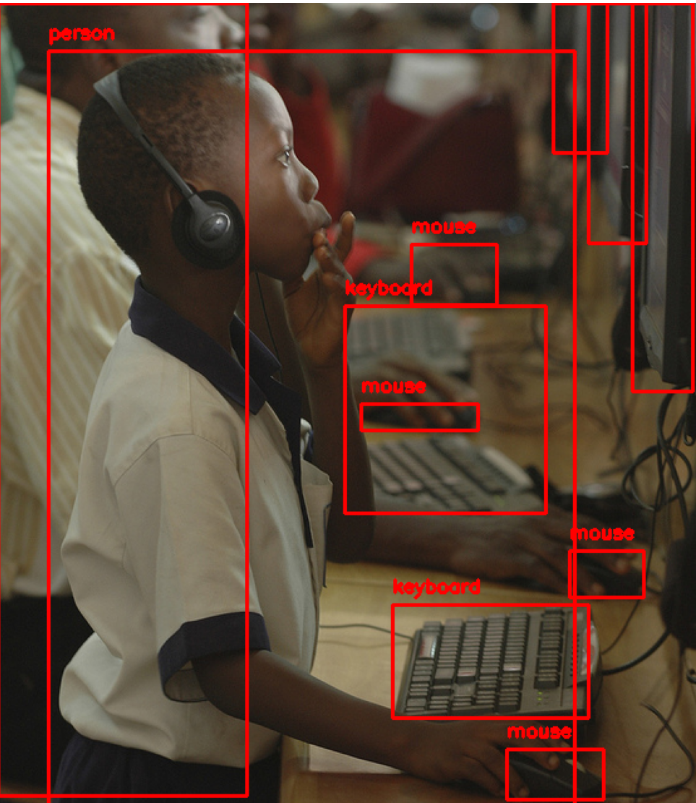
Our Progress
Step 1: Improve the DataSet
C.Result of the Our Improvement
a. All of the Image in DataSet has more than three objects
b. All of the Image in DataSet has a caption and corresponding caption box

Slide 11
Our Progress
Step 2: Improve the Model
Try to play with Model

Slide 12
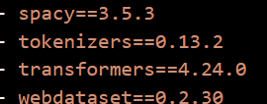
Our Progress - Conflict 1
Step 1: Try to play with the model
Due to conflict of the ENVIRONMENT WHICH THE CREATOR OF THE SUBJECT-DIFFUSION HAD RECOMMENDED (by using environment.yaml) and the ACTUALLY CODE ITSELF we failed to compiled the code
▲requirements inside the
Environment.yaml
▲ Error made trying to compile test.py This is made by conflict made from transformers 4.24.0

Slide 13
Our Progress - Conflict 2
Step 1: Try to play with the model
Due to conflict of the ENVIRONMENT WHICH THE CREATOR OF THE SUBJECT-DIFFUSION HAD RECOMMENDED (by using environment.yaml) and the ACTUALLY CODE ITSELF we failed to compiled the code
▲requirements inside the
Environment.yaml
▲ Error in installing deepspeed 0.7.5, which is unable to find the version although there is the version

Slide 14
Result
0. Remark: What is Subject-Diffusion
Subject-Diffusion is personalized image generation model that only requires a single reference image to support personalized generation of single- or two-subjects in any domain
The steps of the Subject-Diffusion
Dataset Construction
Model of Subject Diffusion

Slide 15
Result
2. Our process of the project
Step 1: Improve the Dataset
Step 2: Try to train the Subject-Diffusion using the Dataset made in Step 1
3. Result
Step 1: We had successfully made the data set using the COCO
Step 2: Due to conflict of the ENVIRONMENT WHICH THE CREATOR OF THE SUBJECT-DIFFUSION HAD RECOMMENDED (by using environment.yaml) and the ACTUALLY CODE ITSELF we failed to compiled the code

Slide 16
Conclusion
While constructing a image diffusion AI, we can find that we have to choose the proper collections of module so that we can avoid the conflict of the modules itself
While trying to improving the diffusion AI, We have to deal with the original code closely so that we can avoid the conflict of the modules itself

Slide 17
Thank You

